Slide 1
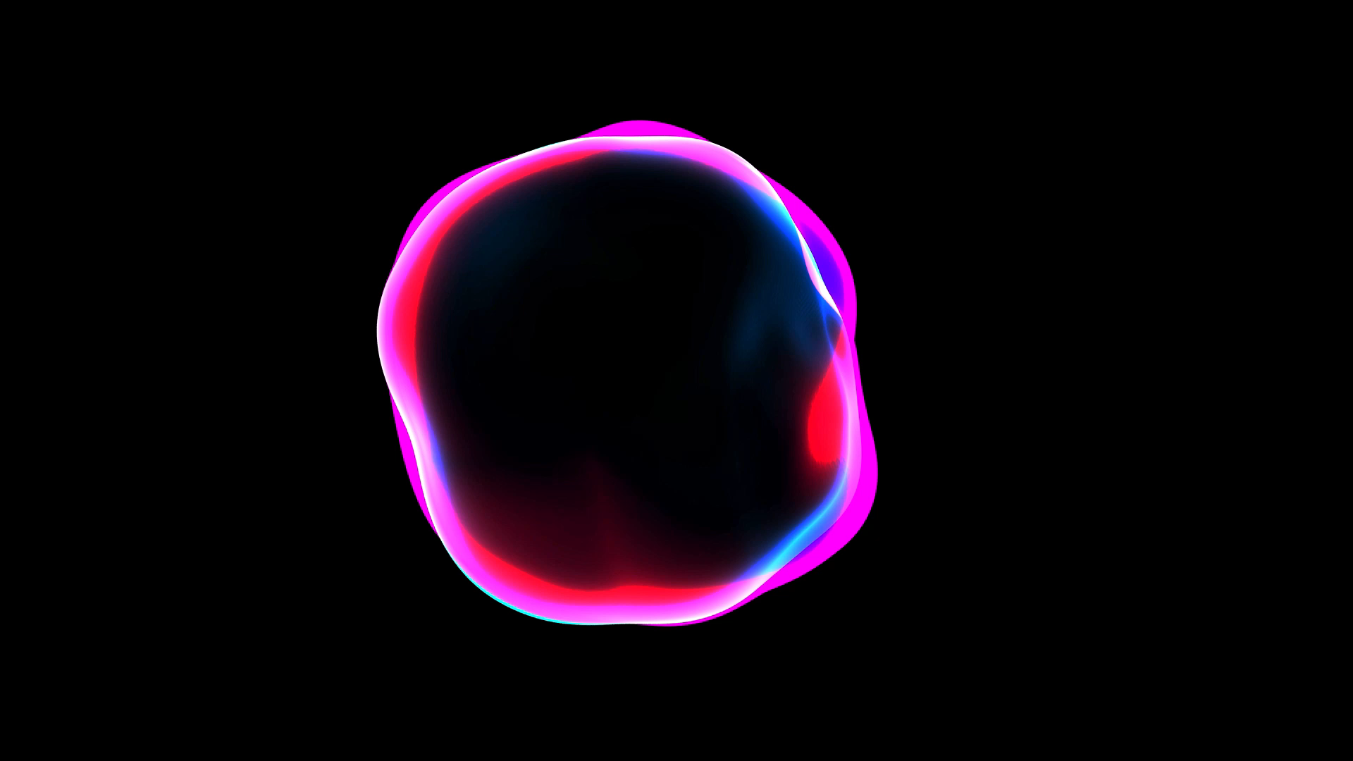
Laser Ablation on Mice Heart Cells
Biophotonics Lab
&
Cardiac Mechanics Research Group

Slide 2
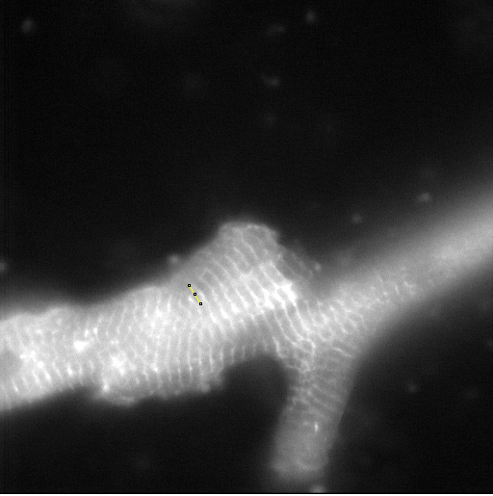
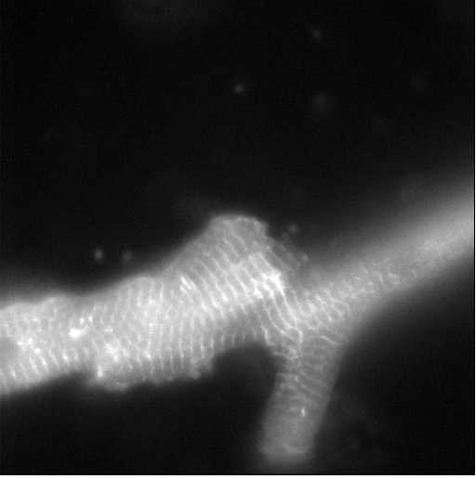
First cut along the strips using 50mW
Pre laser cut
1 min post laser cut

Slide 3
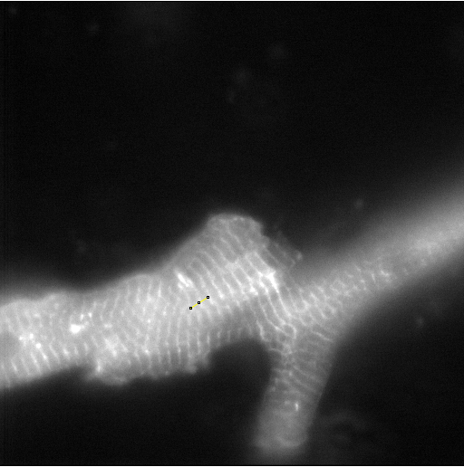
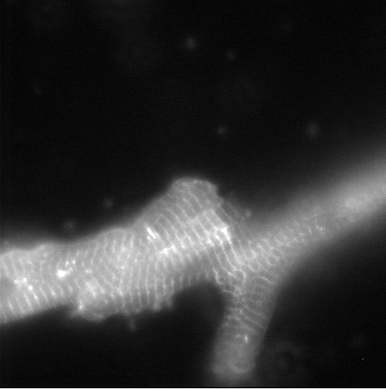
Second cut perpendicular to the strips
1st cut
2nd cut
Pre 2nd laser cut
1 min post 2nd laser cut

